Slide 1
Gene Variant Data Exploration and Modelling
Familial Hypercholesterolemia (FH)
Bethany Schoen
13/06/2024

Slide 2

PROJECT OBJECTIVES
Analyse the relationships between FH diagnoses and Personal & Lifestyle Characteristics
Identify the gene variants most influential on FH diagnoses
Construct a predictive model to determine the presence of FH based on gene variant data

Slide 3
Data Analysis
2213
FH
2761 Patient Records
265
Gene Variants
4 Personal Lifestyle Features
548
other

Slide 4
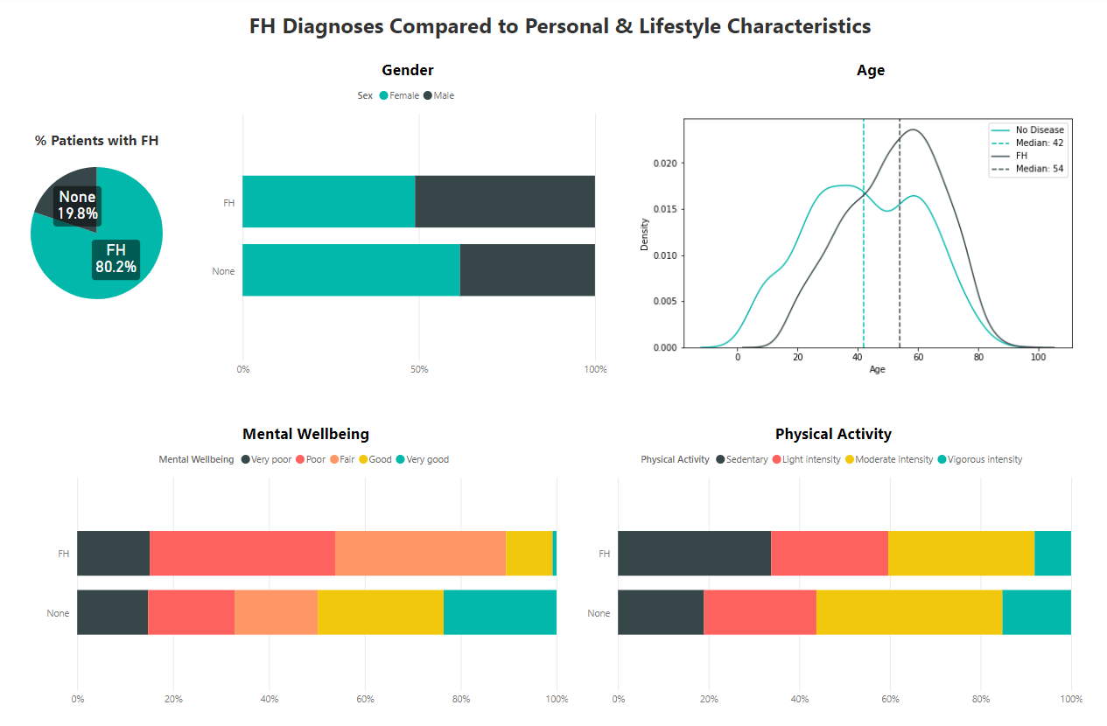
Older distribution of patients with FH
Unbalanced dataset
Majority of people without FH are female
FH Patients have poorer mental wellbeing
FH Patients are less physically active
Statistical tests can be used to prove these hypotheses

Slide 5
Example Hypothesis Tests
The following code snippet and questions demonstrate how to test the relationship between two categorical variables (assuming independence)
Is there a relationship between…
physical activity and mental wellbeing?
Yes (p-value = 1.31e-68)
FH diagnosis and levels of physical activity?
Yes (p-value = 5.62e-14)
Gender and mental wellbeing for all patients with FH?
No (p-value = 0.68)

Slide 6
Influential gene variants

Slide 7
Three Methods Applied
Hypothesis Testing (T-test)
Study the means of individual gene variant features, grouped by FH diagnosis, and test to see if there is a significant difference.
Machine Learning Model Coefficients
Train a parametric ML model such as a Logistic Regressor and study the model coefficients to evaluate importance of each gene variant.
Feature Importance with SHAP
Train an ML model and calculate the SHAP values to see how much each feature contributes to predictions.

Slide 8
Ranked Most Influential Genes
The hypothesis testing identified 31 gene variants correlated to the diagnosis.
All three methods identified the same 3 most influential gene variants.
Var_X100251 and Var_X100248 were considerably more impactful on the diagnosis than any other gene variant.
Hypothesis Testing (T-test)
Machine Learning Model Coefficients
Feature Importance with SHAP
Var_X100248
Var_X100251
Var_X100249
Var_X100250
Var_X100252
Var_X100251
Var_X100248
Var_X100249
Var_X100250
Var_X100252
Var_X100251
Var_X100248
Var_X100249
Var_X100262
Var_X100234

Slide 9
Diagnosis Prediction

Slide 10
Machine Learning (ML)
Classification is the supervised task of grouping data into buckets. The ML model learns how to partition data based on a training dataset so that unseen data points (i.e. undiagnosed patients) can be assigned a label (FH or not).
Three traditional/popular methods were chosen due to their explainability and ease of implementation:
Logistic Regression
K-Nearest Neighbours
XGBoost

Slide 11
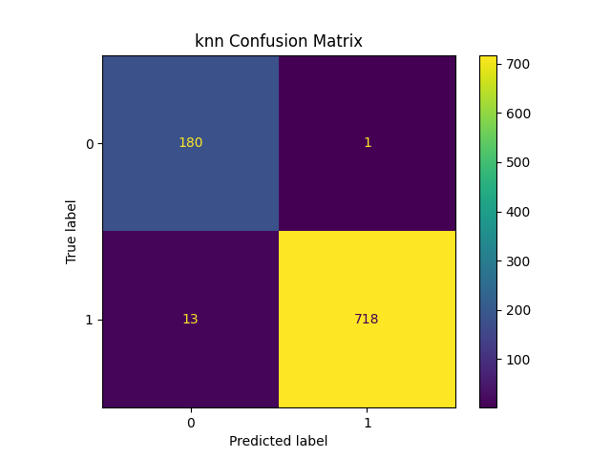

Modelling Results
All trained models were instructed to create predictions on an unseen dataset for which we knew the true classifications. We use this to evaluate how well they perform.
Model | Accuracy | Precision | Recall | F1
LR | 0.973 | 0.986 | 0.979 | 0.983
KNN | 0.985 | 0.999 | 0.982 | 0.99
XGBoost | 0.974 | 0.974 | 0.993 | 0.984
Best performing model
Least false negatives

Slide 12
Data Limitations And Future Work

Slide 13
Data Limitations
Imbalanced data
ideally need more patients without FH
~2000 is a relatively small dataset
Training data needs to be reflective of the population
Validity of self-reported data
Physical activity and mental wellbeing fields could be more meaningful if they were measured values (e.g. avg. number of steps a day)
How were the patients chosen for this dataset?
If they are all BUPA patients, these people will be more conscious of health (bias)
Is FH only identified after a significant cardiac event? (bias)
Additional Fields for Modelling Patient Risk
Other lifestyle factors that impact cholesterol (smoking, drinking, household income)
Other personal factors (height, weight, ethnicity)
Does anyone else in the family have high cholesterol? Has anyone in your family suffered from strokes or heart attacks?

Slide 14
Future Work
Deep Learning
More intensive pattern recognition techniques for larger datasets or more complex decision boundaries
Model priors
Do we already know the prevalence of FH in BUPA patients/national population?
Outlier Detection
Are there any patients in the dataset whose information does not follow the trend of others in their group?
Combined Feature Importance
Use techniques like bagging to interpret the importance of a combination of features
Patient Risk Model
Considering personal, lifestyle, and gene variant factors, how at risk is a patient of suffering from high cholesterol?

Slide 15




Thank you

